Slide 1
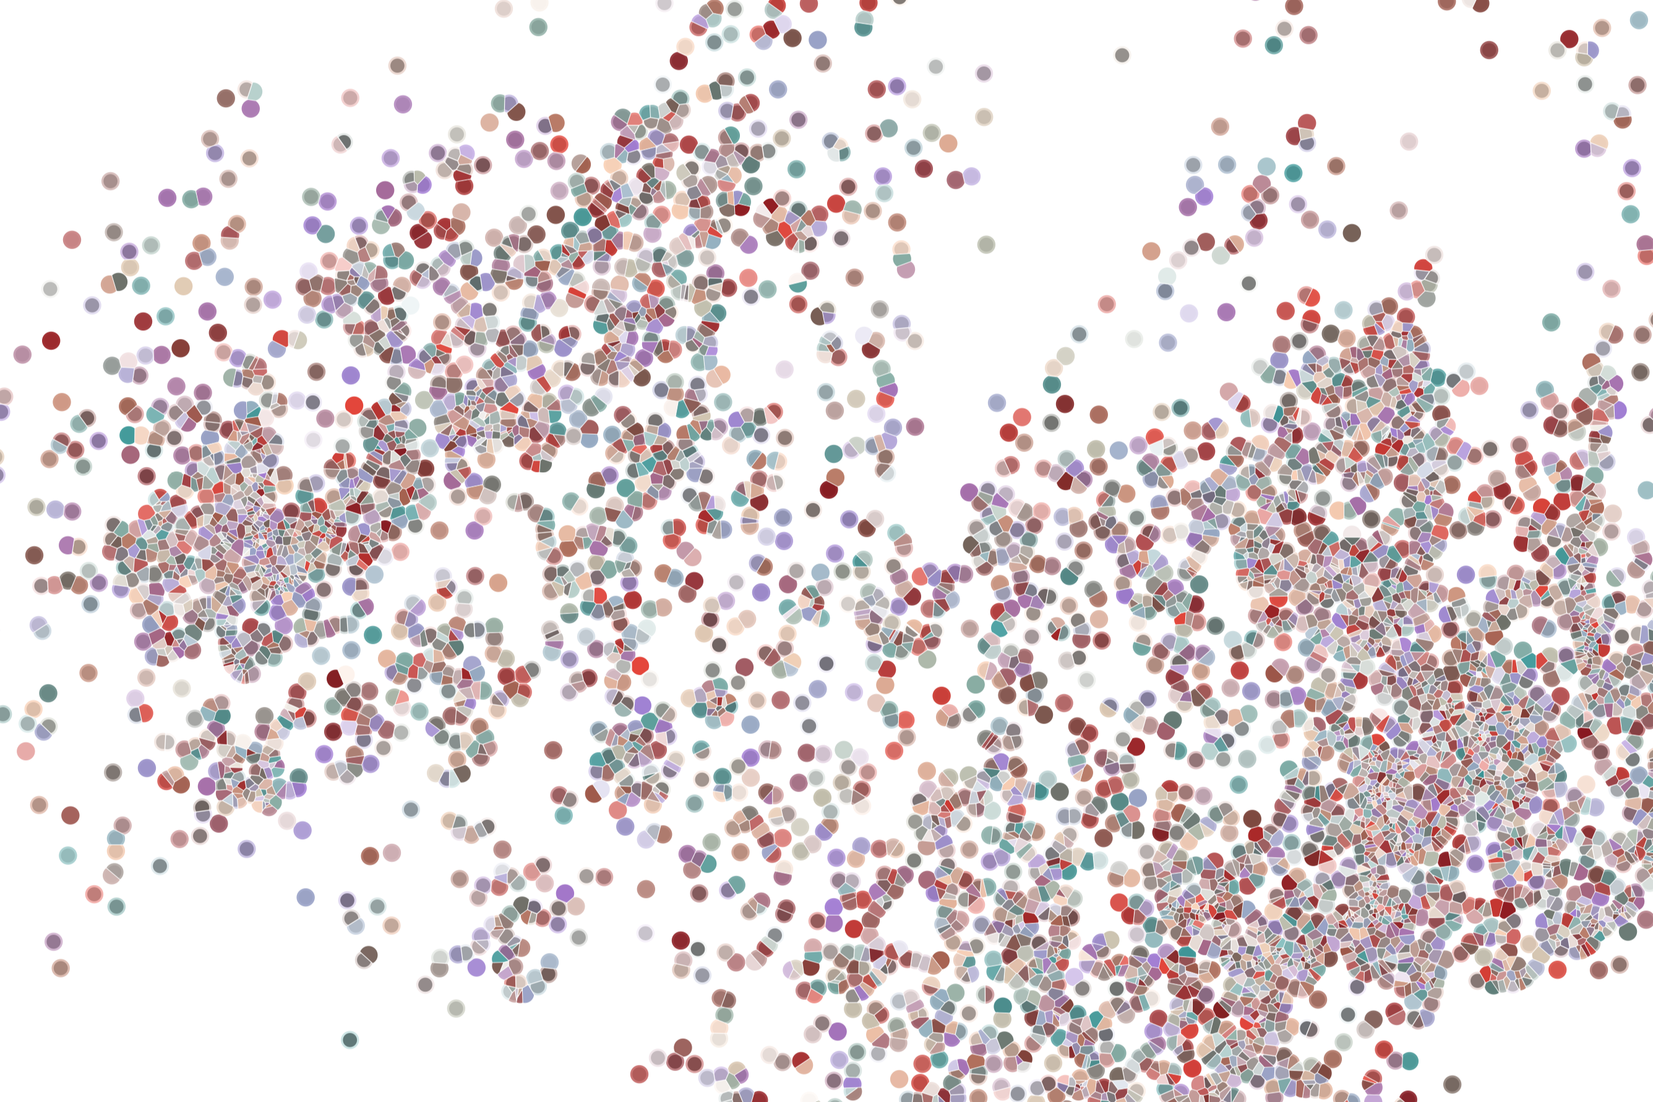
Lecture 1 Experimental design of scRNAseq projects
Physalia course 2021 — Single-cell RNA-seq with R/Bioconductor
Instructors: Jacques Serizay
Notes:
Hello everybody and thank you for attending my presentation. I am going to talk about the project I recently started working on in the Spassky and Koszul labs, both located in Paris. This project focuses on the unusual cooption of the mitotic machinery to drive, not cell division but cell differentiation.

Slide 2

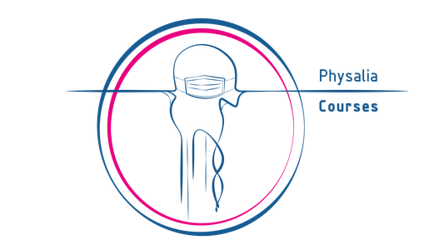
scRNAseq analysis workshop
Overall goals
Introduction to the rapidly expanding world of single-cell transcriptomics
Focus on specific software tools but also on underlying concepts - so down the line, you can make informed choices
Hands-on homework analyzing single-cell heterogeneity
Create a fun, learning, collaborative, and interactive environment
Notes:
I would like to expand these observations to in vivo data. I also want to check what happens in terms of transcriptional dynamics in cells where Cyclin O, a key non-canonical cyclin involved in MCC diff., is knocked-out.

Slide 3
scRNAseq analysis workshop
Organization
Workshop webpage: https://jserizay.com/scRNAseq-workshop
Github repo: https://github.com/js2264/scRNAseq-workshop
Zoom link: https://us02web.zoom.us/j/89781144695?pwd=Q1dUNmZmSGlXdGpJQkl4TUwwQm52Zz09
Raise hand in Zoom to ask questions, use chat or even interrupt me if needed!
Please use video, it’s much nicer to chat with faces than with black walls!
Mute microphone when not in use
Please be patient with technical issues (network, Zoom, etc...)
Notes:
I would like to expand these observations to in vivo data. I also want to check what happens in terms of transcriptional dynamics in cells where Cyclin O, a key non-canonical cyclin involved in MCC diff., is knocked-out.

Slide 4
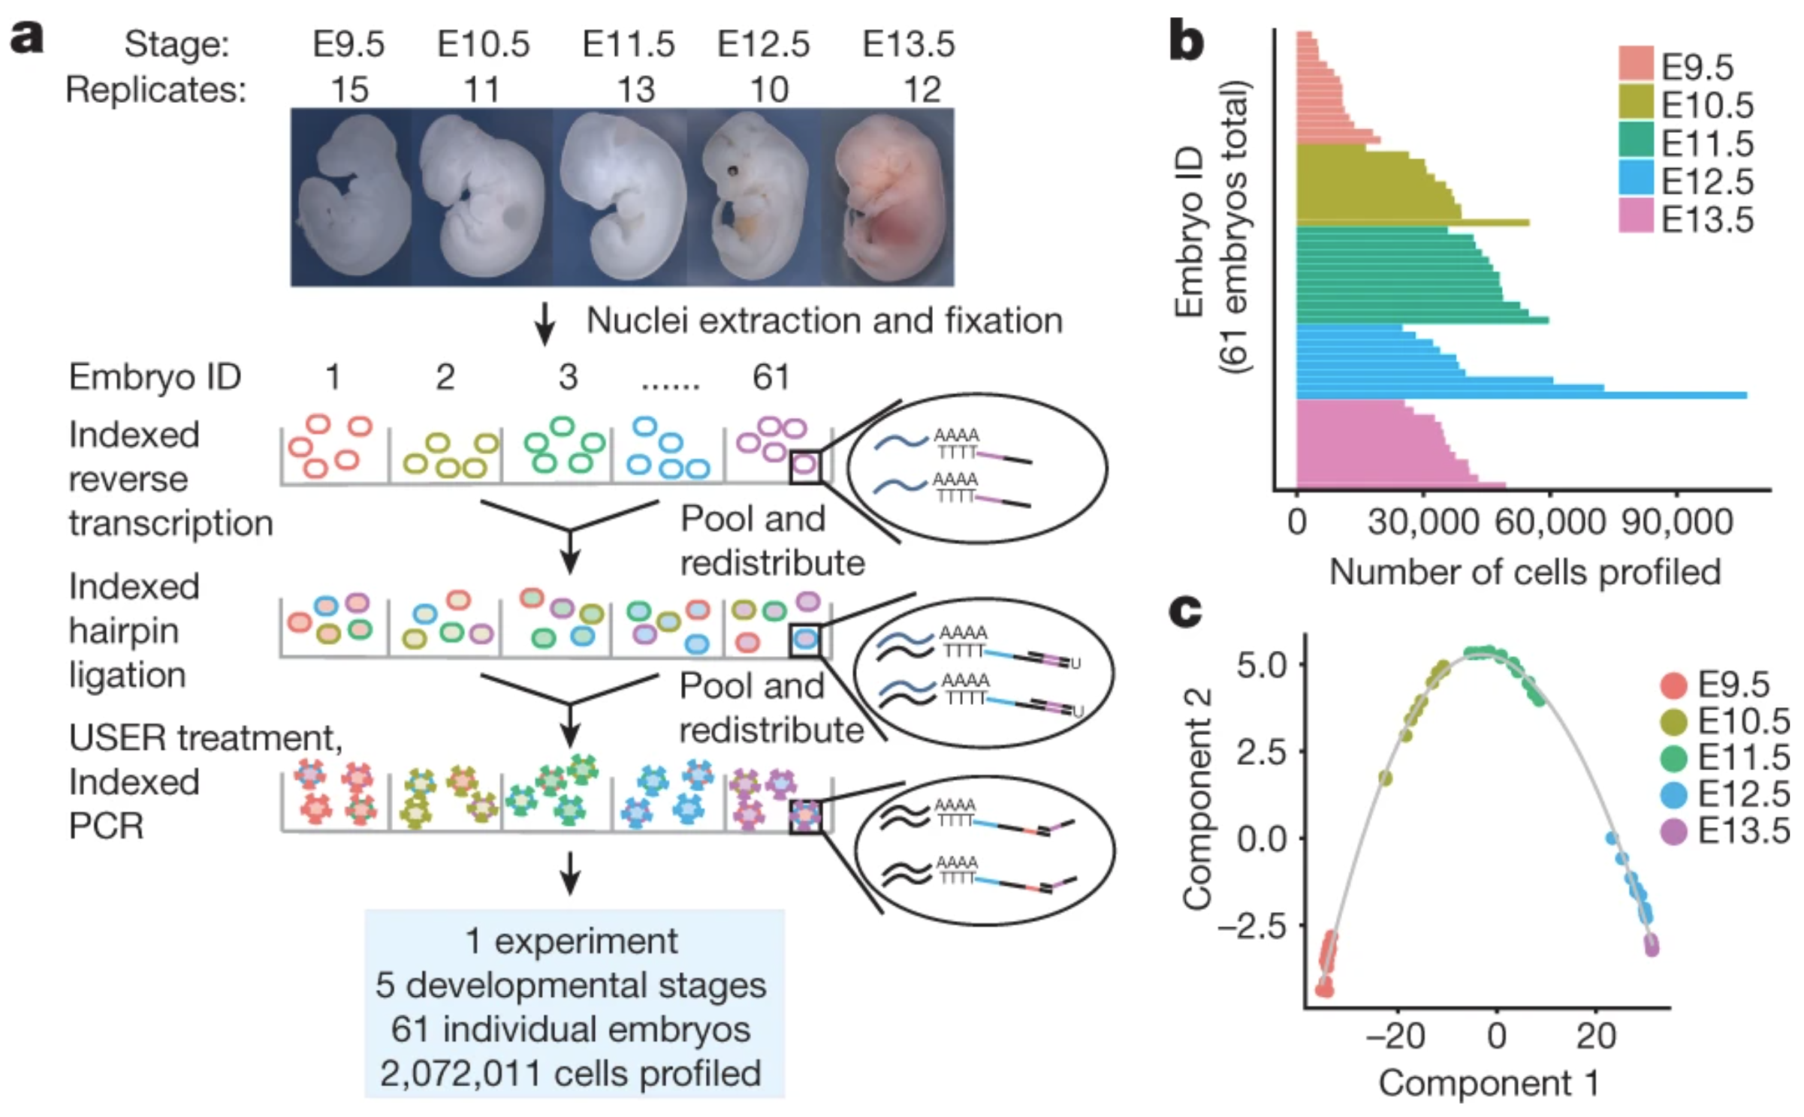
Single-cell RNA-seq studies: From small-ish scale to massive scale
Cao & Spielmann, Nature 2019
Notes:
I would like to expand these observations to in vivo data. I also want to check what happens in terms of transcriptional dynamics in cells where Cyclin O, a key non-canonical cyclin involved in MCC diff., is knocked-out.

Slide 5
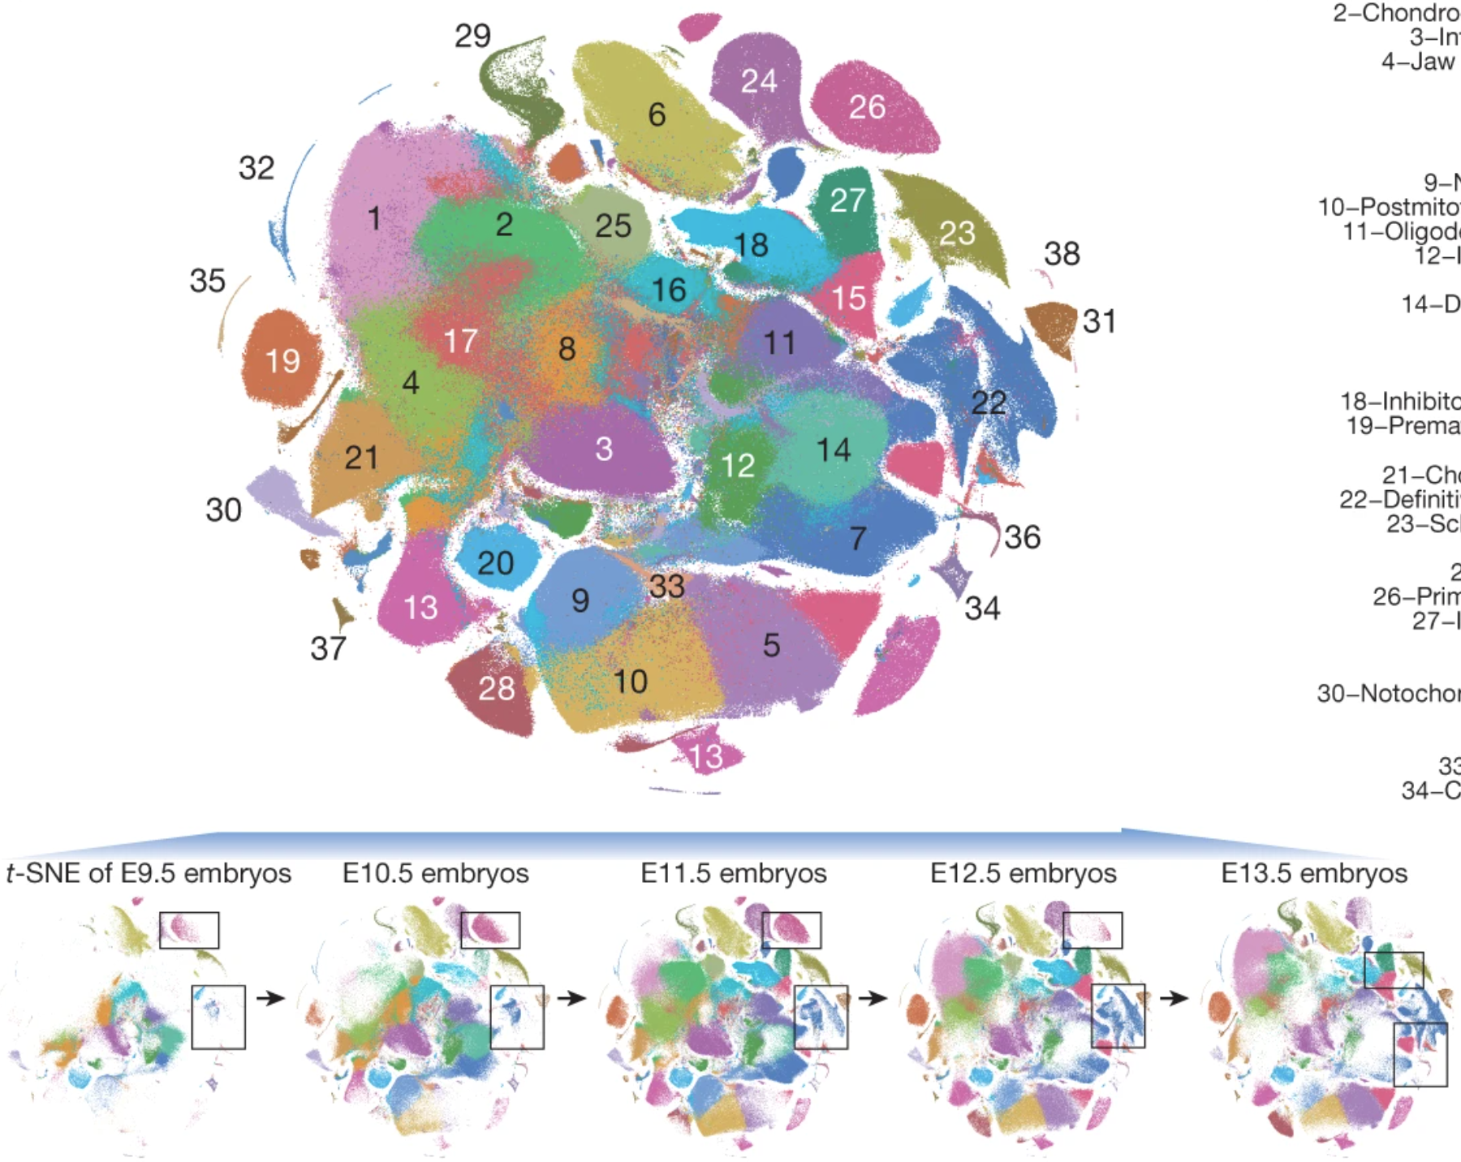
Single-cell RNA-seq studies: From small-ish scale to massive scale
Clustering and visualization of 2,026,641 mouse embryo cells
Cao & Spielmann, Nature 2019
Notes:
I would like to expand these observations to in vivo data. I also want to check what happens in terms of transcriptional dynamics in cells where Cyclin O, a key non-canonical cyclin involved in MCC diff., is knocked-out.

Slide 6
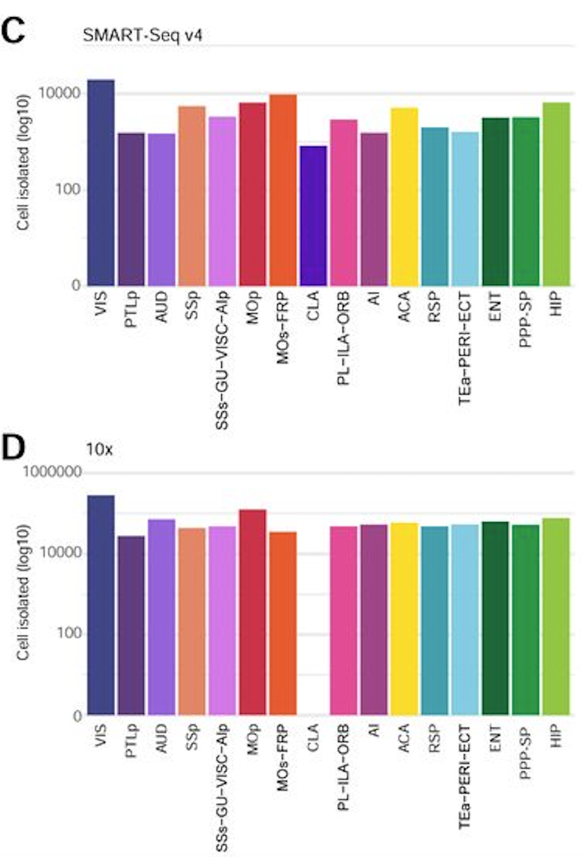
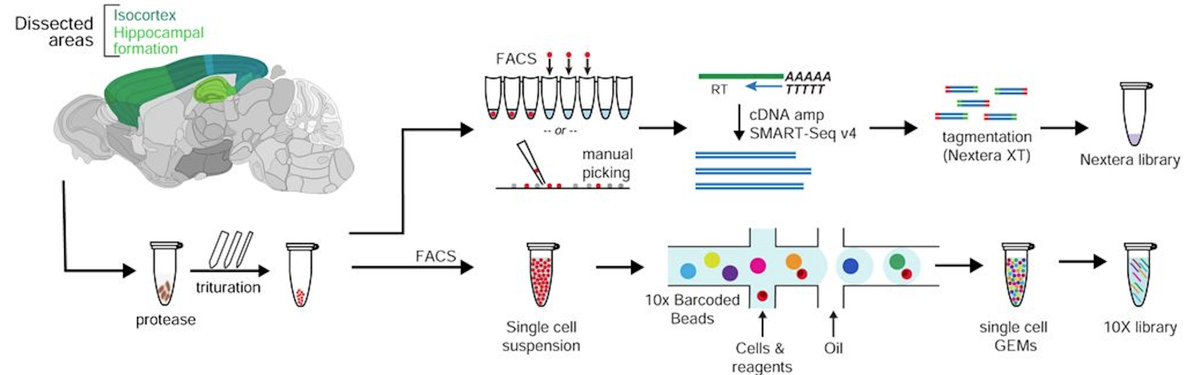
Single-cell RNA-seq studies: From small-ish scale to massive scale
Yao et al., Cell 2021
Notes:
I would like to expand these observations to in vivo data. I also want to check what happens in terms of transcriptional dynamics in cells where Cyclin O, a key non-canonical cyclin involved in MCC diff., is knocked-out.

Slide 7
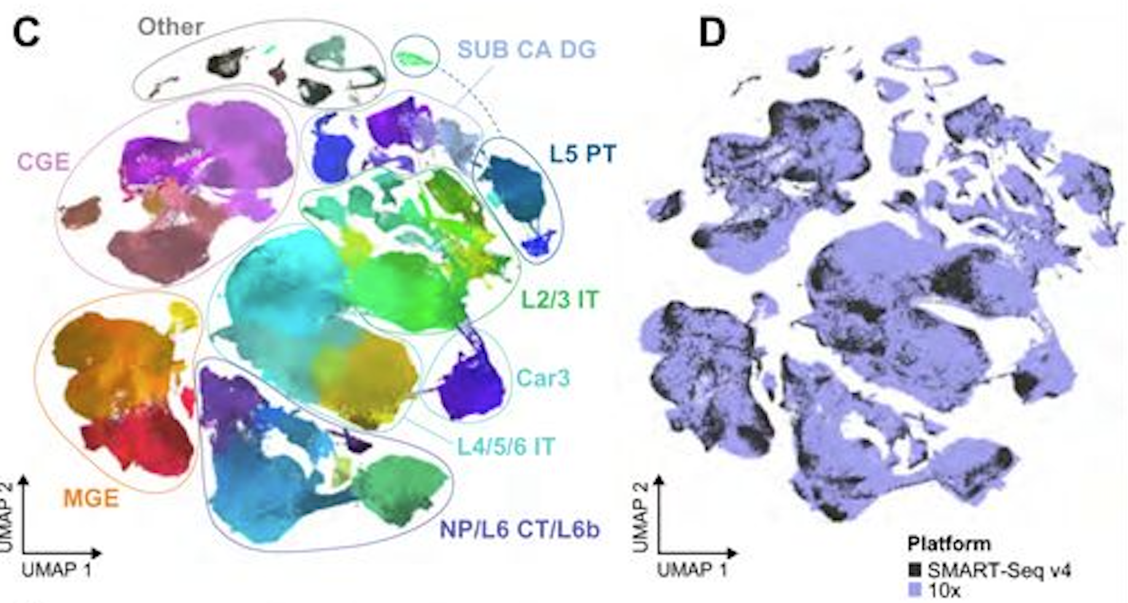
Single-cell RNA-seq studies: From small-ish scale to massive scale
Yao et al., Cell 2021
Notes:
I would like to expand these observations to in vivo data. I also want to check what happens in terms of transcriptional dynamics in cells where Cyclin O, a key non-canonical cyclin involved in MCC diff., is knocked-out.

Slide 8
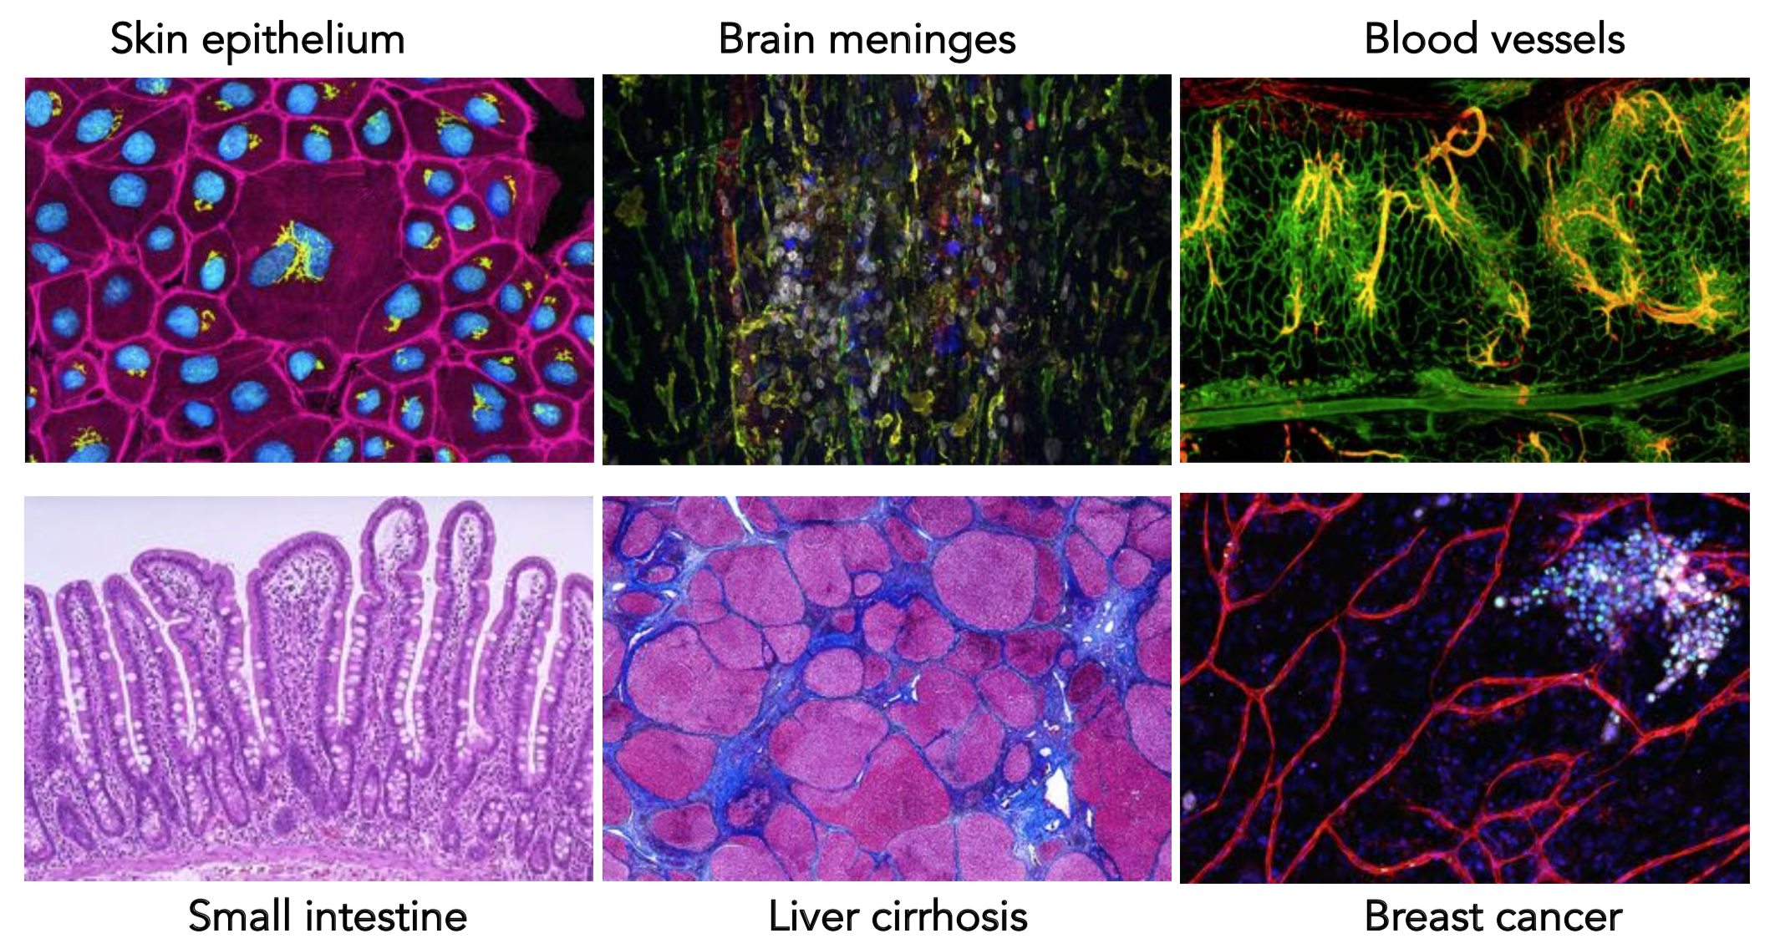
Single-cell RNA-seq studies: What are you interested in?
Incredible diversity in cell types, states, and interactions across tissues of an animal.
http://www.cell.com/pictureshow/skin
https://library.med.utah.edu/WebPath/webpath.html
Notes:
I would like to expand these observations to in vivo data. I also want to check what happens in terms of transcriptional dynamics in cells where Cyclin O, a key non-canonical cyclin involved in MCC diff., is knocked-out.

Slide 9
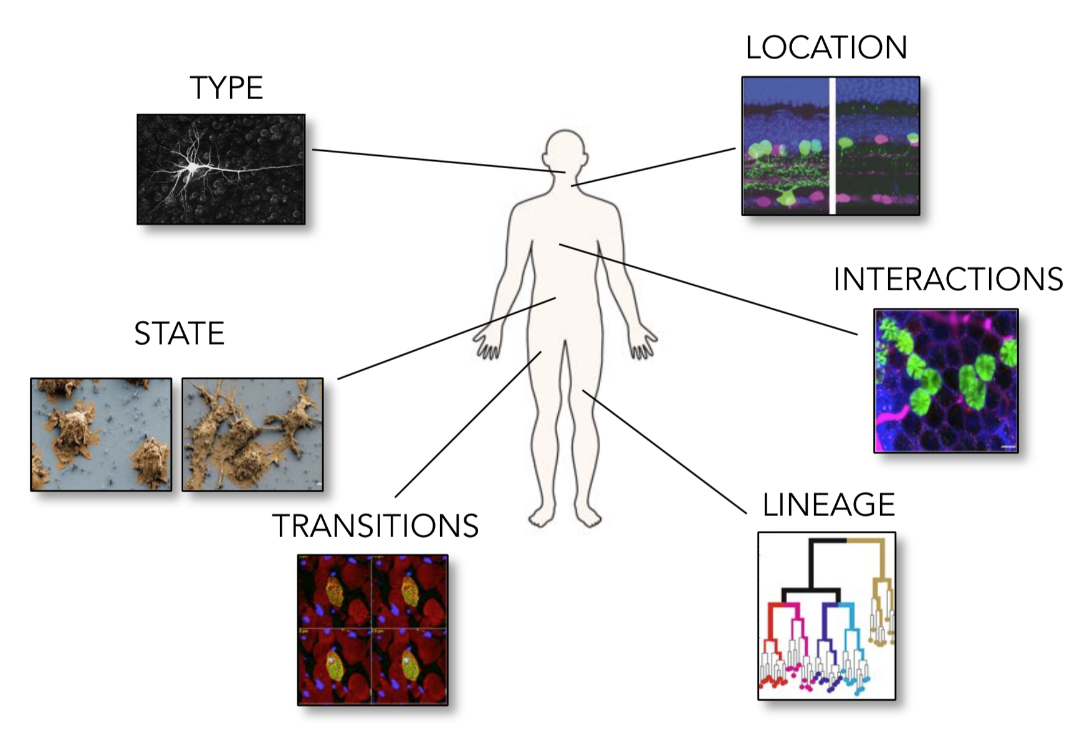
Single-cell RNA-seq studies: What are you interested in?
A cell’s identity and fate are shaped by many features.
Notes:
I would like to expand these observations to in vivo data. I also want to check what happens in terms of transcriptional dynamics in cells where Cyclin O, a key non-canonical cyclin involved in MCC diff., is knocked-out.

Slide 10
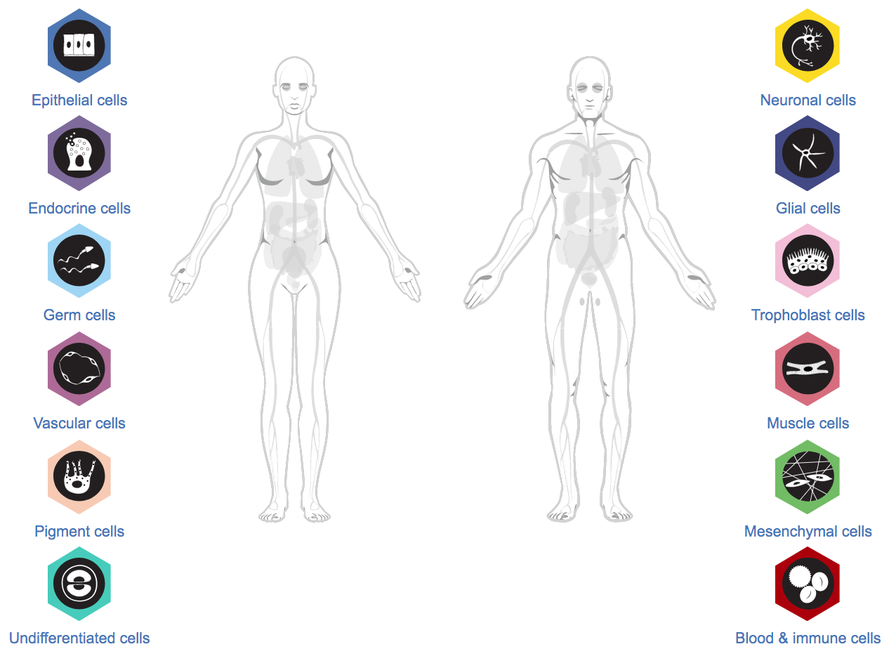
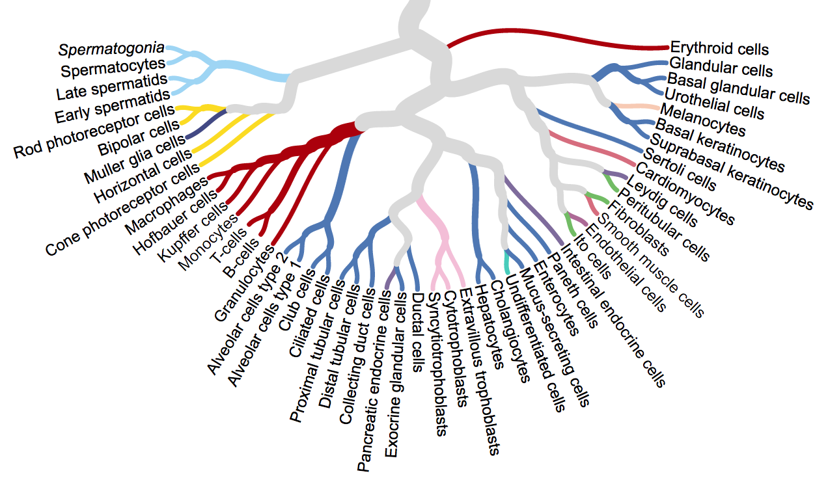
Single-cell RNA-seq studies: What are you interested in?
A cell’s identity and fate are shaped by many features.
The Human Protein Atlas
Notes:
I would like to expand these observations to in vivo data. I also want to check what happens in terms of transcriptional dynamics in cells where Cyclin O, a key non-canonical cyclin involved in MCC diff., is knocked-out.

Slide 11
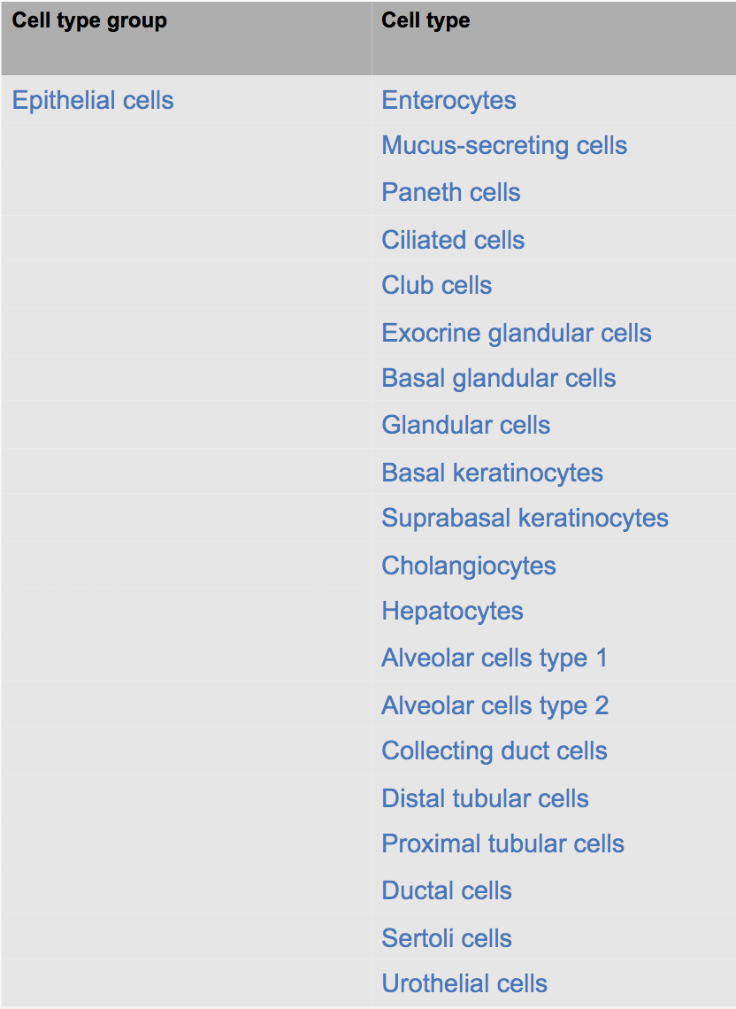
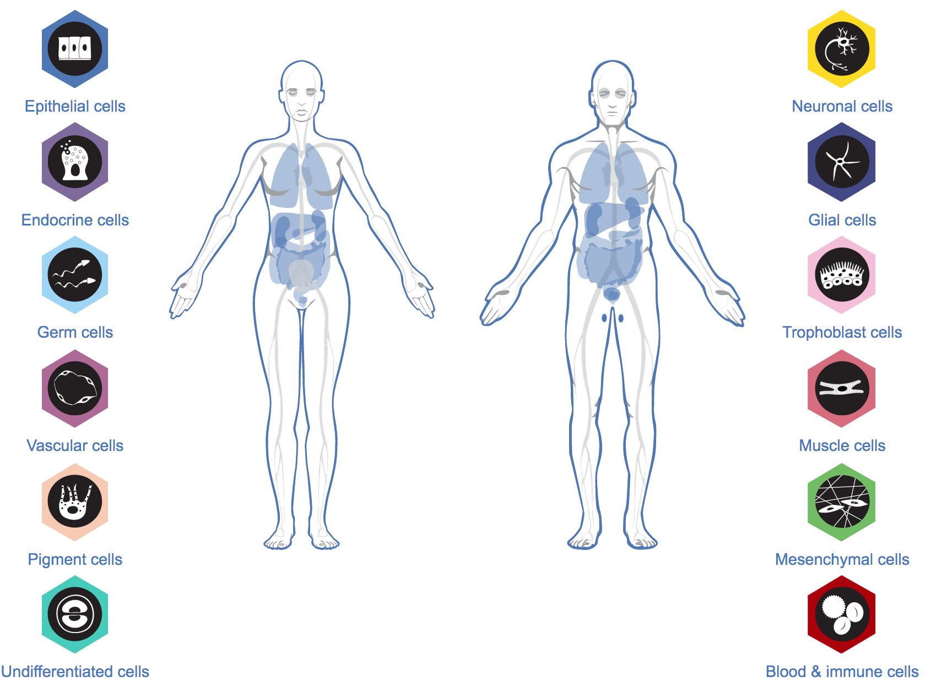
Single-cell RNA-seq studies: What are you interested in?
A cell’s identity and fate are shaped by many features.
The Human Protein Atlas
Notes:
I would like to expand these observations to in vivo data. I also want to check what happens in terms of transcriptional dynamics in cells where Cyclin O, a key non-canonical cyclin involved in MCC diff., is knocked-out.

Slide 12
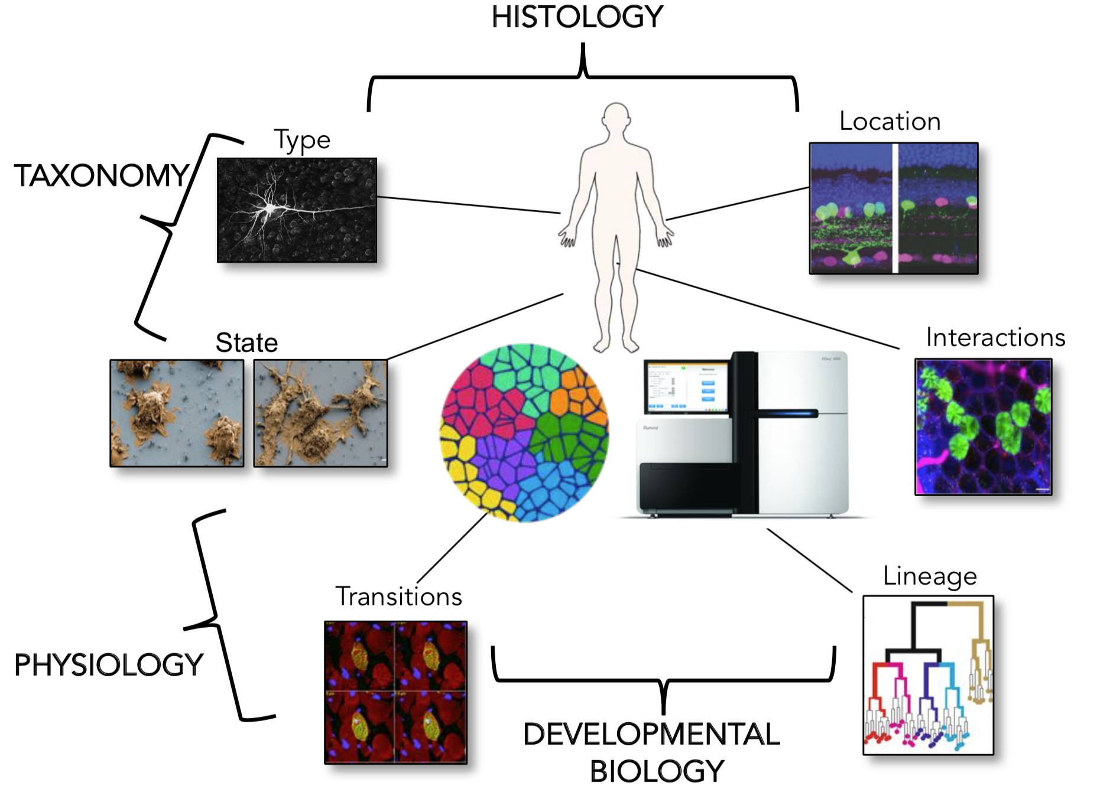
Single-cell RNA-seq studies: What are you interested in?
A cell type is inherently based on one’s area of study.
Notes:
I would like to expand these observations to in vivo data. I also want to check what happens in terms of transcriptional dynamics in cells where Cyclin O, a key non-canonical cyclin involved in MCC diff., is knocked-out.

Slide 13
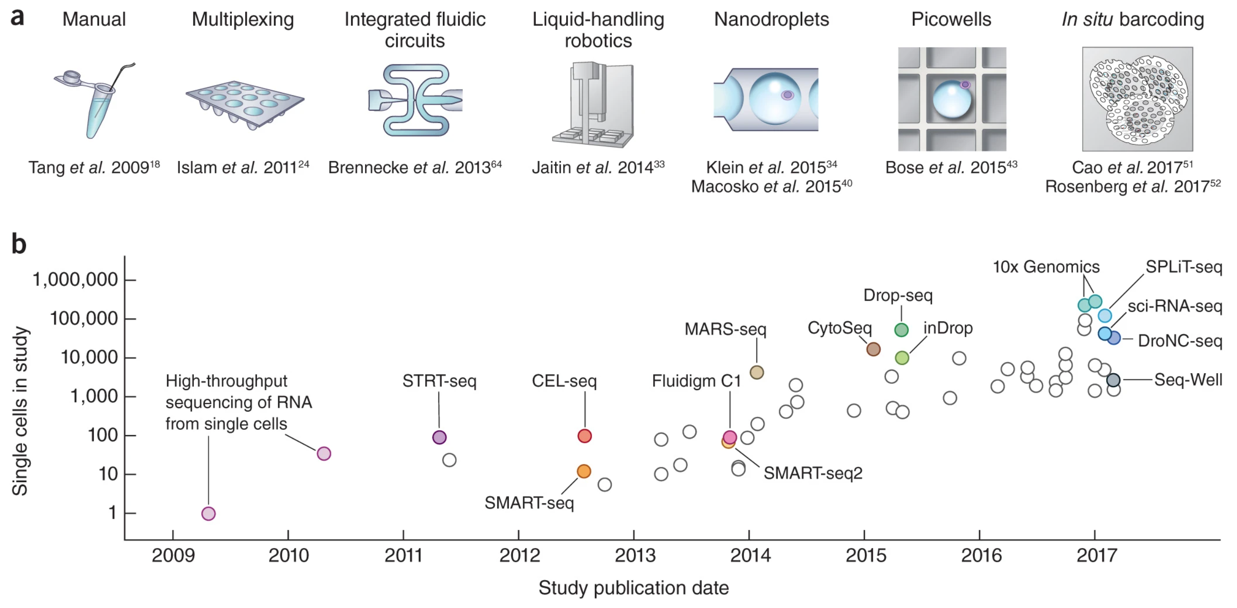
Single-cell RNA-seq studies: From small-ish scale to massive scale
Svensonn et al., Nat. Protocols 2018
Notes:
I would like to expand these observations to in vivo data. I also want to check what happens in terms of transcriptional dynamics in cells where Cyclin O, a key non-canonical cyclin involved in MCC diff., is knocked-out.

Slide 14
Droplet-based or plate-based approaches
Valentine Svensson, Nat. Biotech. 2021 (Correspondence)
“ The typical choice for a researcher interested in performing scRNA-seq is between the commercial 10x Genomics Chromium Single Cell Gene Expression Solution and variants of the SMART-seq protocol (either Smart-seq2 or the commercial SMARTer v4 Ultra Low Input RNA Kit from Takara Bio).”
Notes:
I would like to expand these observations to in vivo data. I also want to check what happens in terms of transcriptional dynamics in cells where Cyclin O, a key non-canonical cyclin involved in MCC diff., is knocked-out.

Slide 15
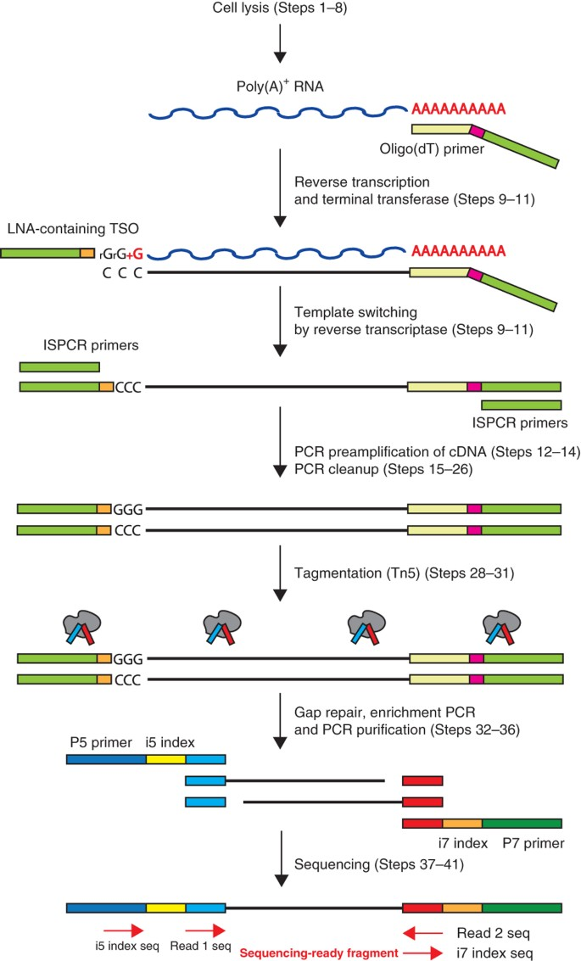
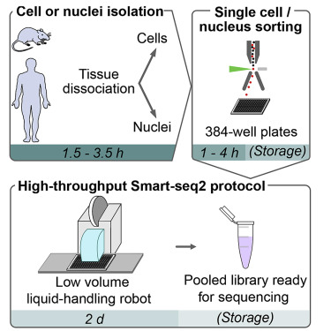
Droplet-based or plate-based approaches
Smart-seq2:
Picelli et al, Nature 2014
Jaeger et al., STAR protocols 2020
Notes:
I would like to expand these observations to in vivo data. I also want to check what happens in terms of transcriptional dynamics in cells where Cyclin O, a key non-canonical cyclin involved in MCC diff., is knocked-out.

Slide 16
Droplet-based or plate-based approaches
Smart-seq2:
Plate-based approach, ”real” RNA-seq sequencing with standard biases
Full-length transcriptomics
High coverage of the transcriptome
Index sort
Specialized equipment
Low throughput
Hence more expensive
Notes:
I would like to expand these observations to in vivo data. I also want to check what happens in terms of transcriptional dynamics in cells where Cyclin O, a key non-canonical cyclin involved in MCC diff., is knocked-out.

Slide 17
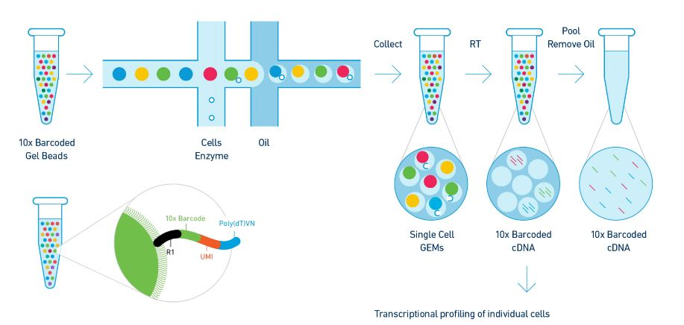
Droplet-based or plate-based approaches
10X Genomics:
Notes:
I would like to expand these observations to in vivo data. I also want to check what happens in terms of transcriptional dynamics in cells where Cyclin O, a key non-canonical cyclin involved in MCC diff., is knocked-out.

Slide 18
Droplet-based or plate-based approaches
10X Genomics:
Droplet-based approach, sequencing 3’-end of RNAs, highly specific biases
High to very-high throughput
(Relatively) easy to combine with multi-omics
3’-end only is sequenced
Low coverage of the transcriptome
Notes:
I would like to expand these observations to in vivo data. I also want to check what happens in terms of transcriptional dynamics in cells where Cyclin O, a key non-canonical cyclin involved in MCC diff., is knocked-out.

Slide 19
So what to do with all this data?
Rough calculation: ~ 200M cells have now been published…
(and probably at least the same amount unpublished!)
Notes:
I would like to expand these observations to in vivo data. I also want to check what happens in terms of transcriptional dynamics in cells where Cyclin O, a key non-canonical cyclin involved in MCC diff., is knocked-out.

Slide 20
Human Cell Atlas: profiling ALL the cells in the human body
Human Cell Atlas mission:
“To create comprehensive reference maps of all human cells — the fundamental units of life — as a basis for both understanding human health and diagnosing, monitoring, and treating disease.”
Notes:
I would like to expand these observations to in vivo data. I also want to check what happens in terms of transcriptional dynamics in cells where Cyclin O, a key non-canonical cyclin involved in MCC diff., is knocked-out.

Slide 21
Human Cell Atlas: profiling ALL the cells in the human body
Human Cell Atlas mission:
“To create comprehensive reference maps of all human cells — the fundamental units of life — as a basis for both understanding human health and diagnosing, monitoring, and treating disease.”
Founded in 2016
Collaborative approach: everyone can contribute with their own project
2,000 members (1,000 institutes)
442 projects
Notes:
I would like to expand these observations to in vivo data. I also want to check what happens in terms of transcriptional dynamics in cells where Cyclin O, a key non-canonical cyclin involved in MCC diff., is knocked-out.

Slide 22
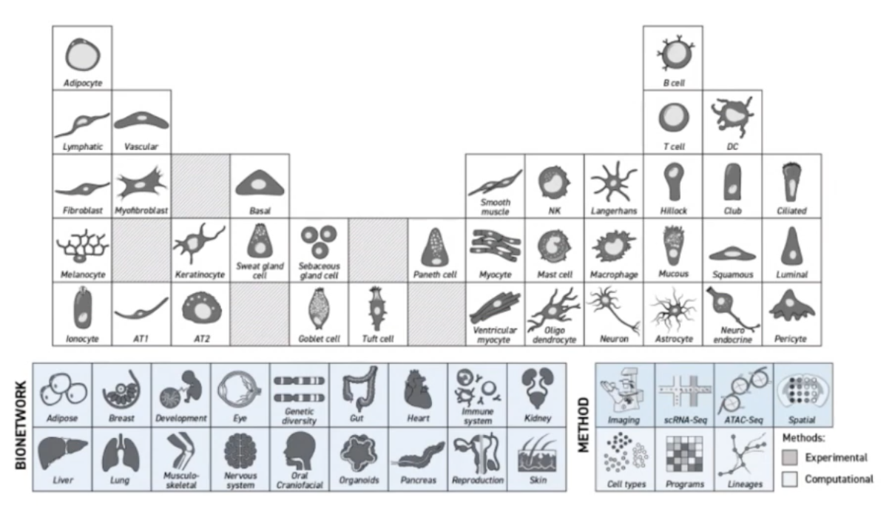
Human Cell Atlas: profiling ALL the cells in the human body
The Human Cell Atlas will catalogue all the cells in a human body.
Notes:
I would like to expand these observations to in vivo data. I also want to check what happens in terms of transcriptional dynamics in cells where Cyclin O, a key non-canonical cyclin involved in MCC diff., is knocked-out.

Slide 23
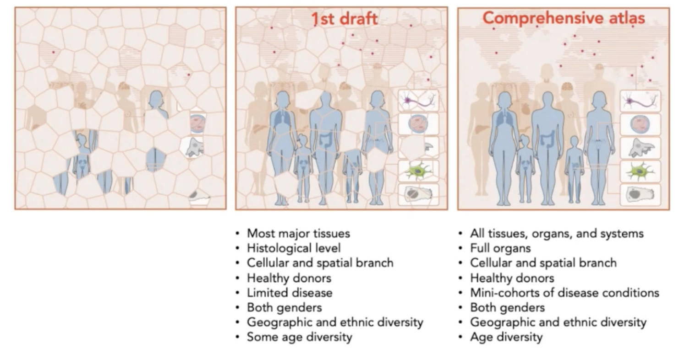
Human Cell Atlas: profiling ALL the cells in the human body
This will take years…
Notes:
I would like to expand these observations to in vivo data. I also want to check what happens in terms of transcriptional dynamics in cells where Cyclin O, a key non-canonical cyclin involved in MCC diff., is knocked-out.

Slide 24
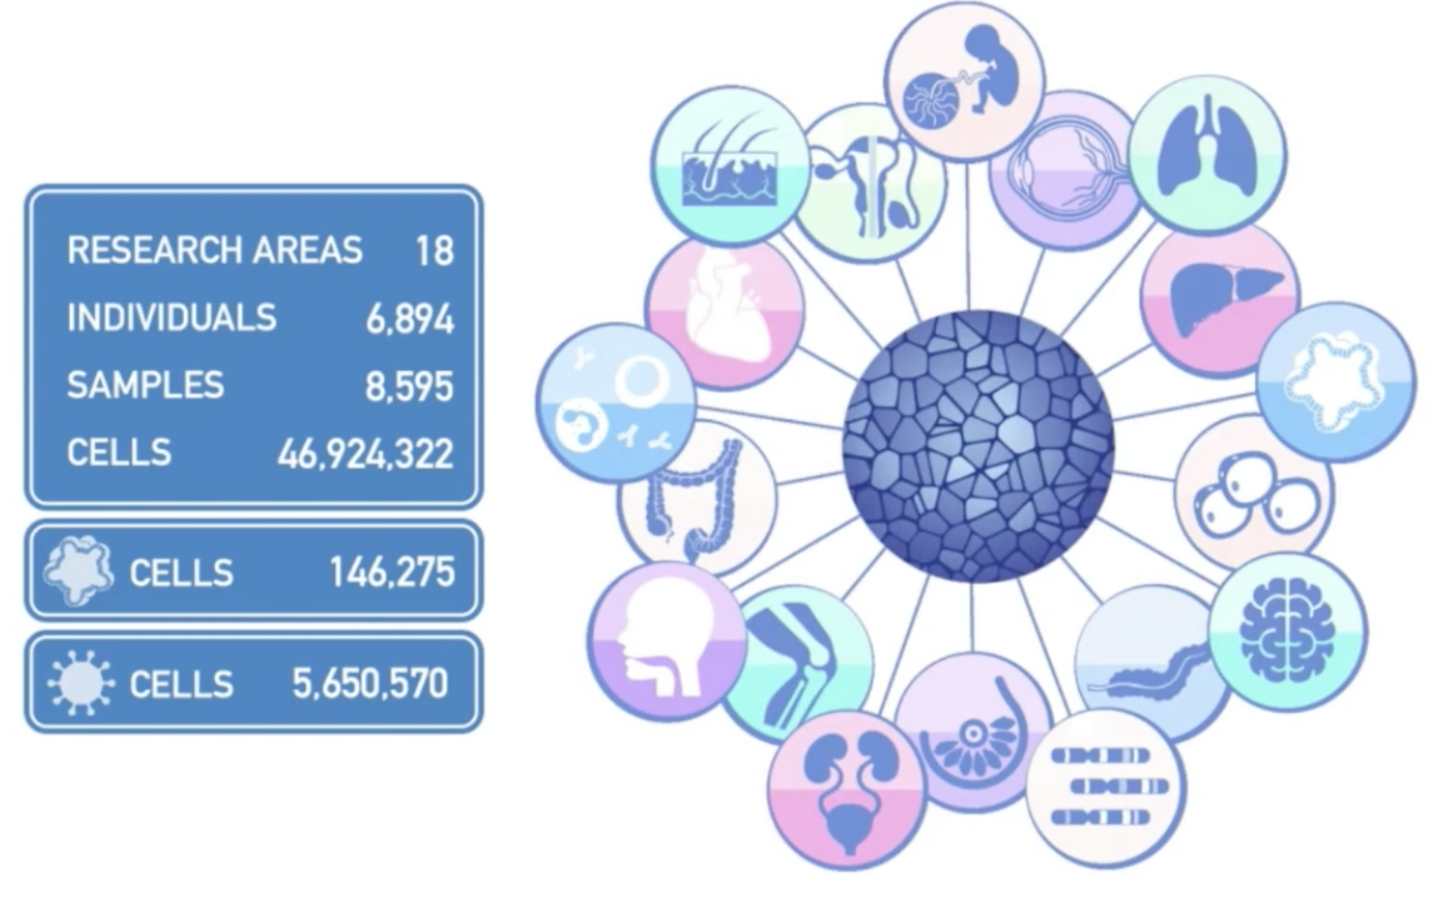
Human Cell Atlas: profiling ALL the cells in the human body
Current state of the HCA: already beyond its original “first draft” aim.
Notes:
I would like to expand these observations to in vivo data. I also want to check what happens in terms of transcriptional dynamics in cells where Cyclin O, a key non-canonical cyclin involved in MCC diff., is knocked-out.

Slide 25
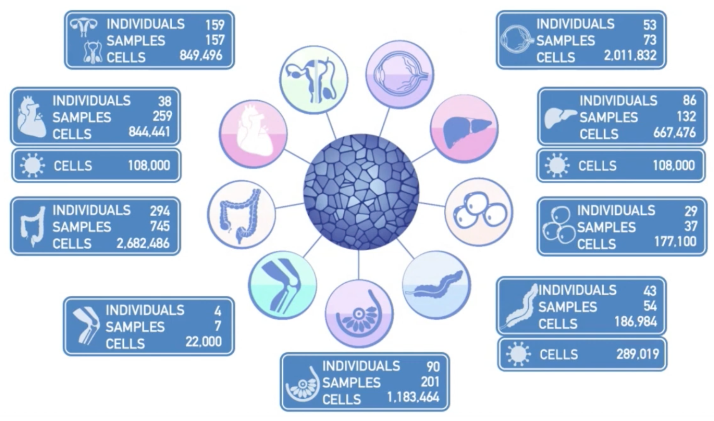
Human Cell Atlas: profiling ALL the cells in the human body
Current state of the HCA: already beyond its original “first draft” aim.
Notes:
I would like to expand these observations to in vivo data. I also want to check what happens in terms of transcriptional dynamics in cells where Cyclin O, a key non-canonical cyclin involved in MCC diff., is knocked-out.

Slide 26
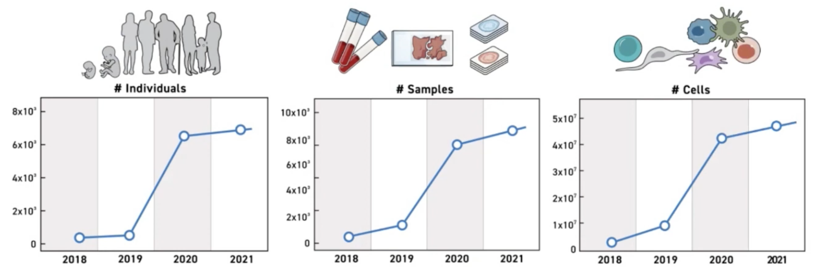
Human Cell Atlas: profiling ALL the cells in the human body
Current state of the HCA: already beyond its original “first draft” aim.
Notes:
I would like to expand these observations to in vivo data. I also want to check what happens in terms of transcriptional dynamics in cells where Cyclin O, a key non-canonical cyclin involved in MCC diff., is knocked-out.

Slide 27
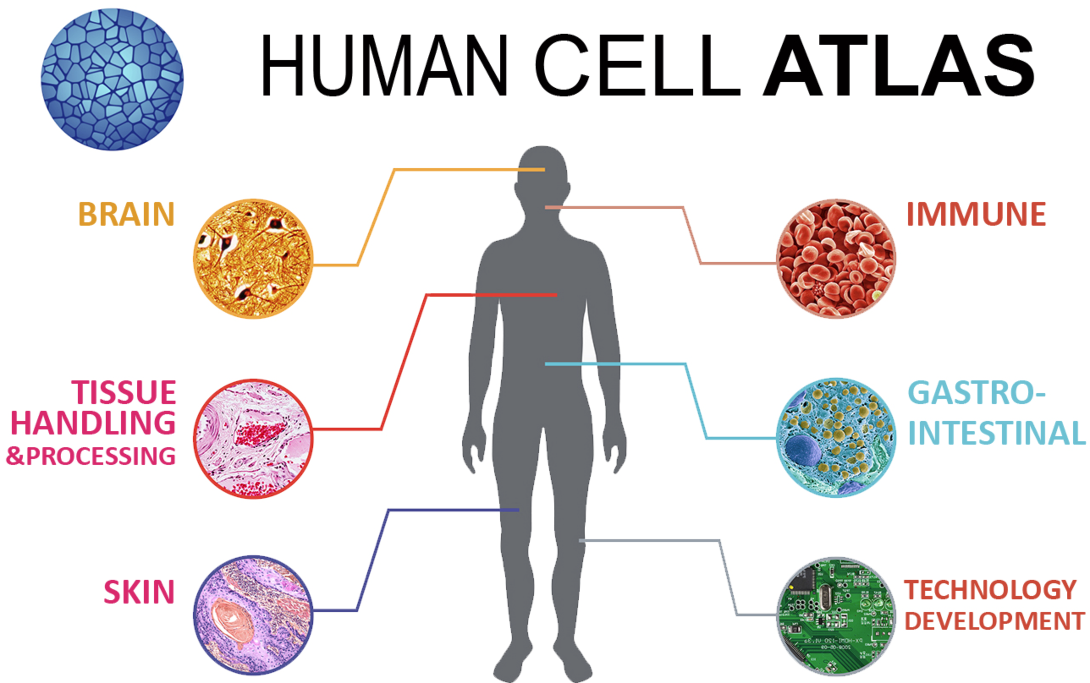
Human Cell Atlas: profiling ALL the cells in the human body
It will not only characterize each cell type of the human’s body, but will also lead technological advances and improve experimental approaches for single-cell studies.
Notes:
I would like to expand these observations to in vivo data. I also want to check what happens in terms of transcriptional dynamics in cells where Cyclin O, a key non-canonical cyclin involved in MCC diff., is knocked-out.

Slide 28
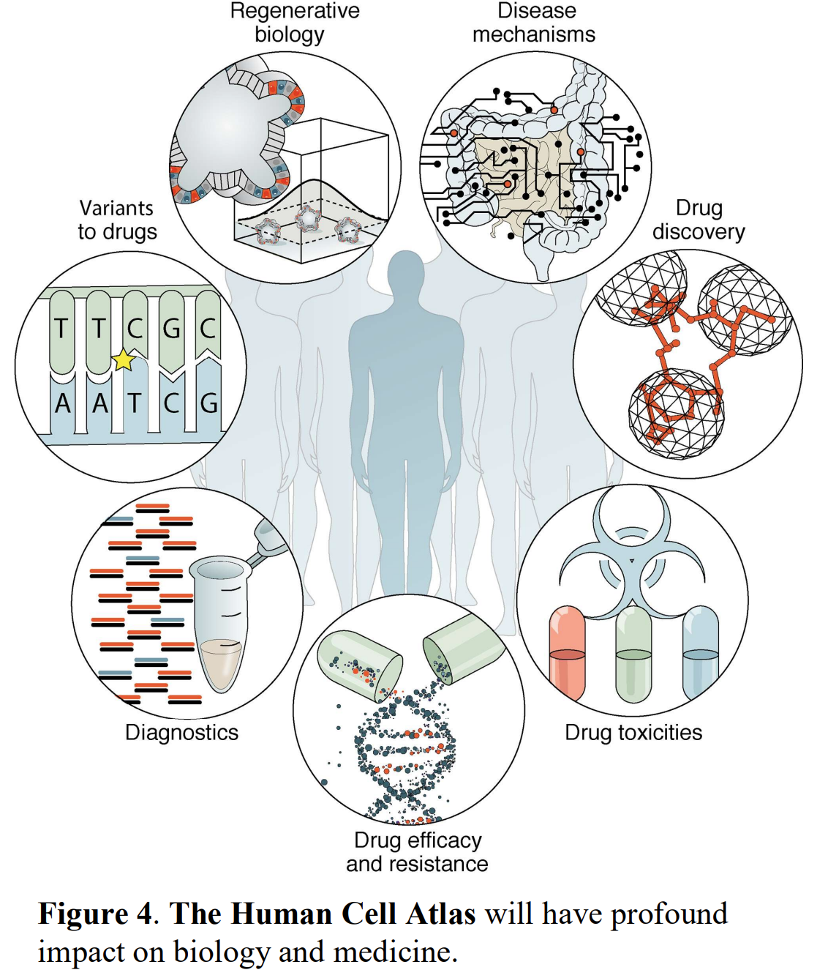
Human Cell Atlas: profiling ALL the cells in the human body
The Human Cell Atlas will have profound impact on biology and medecine.
Notes:
I would like to expand these observations to in vivo data. I also want to check what happens in terms of transcriptional dynamics in cells where Cyclin O, a key non-canonical cyclin involved in MCC diff., is knocked-out.

Slide 29
Resources
HCA data portal: https://data.humancellatlas.org/explore/projects
Teichmann lab: http://www.teichlab.org/data
Hemberg lab (partially) reprocessed datasets: https://hemberg-lab.github.io/scRNA.seq.datasets/
Broad’s single cell portal: https://singlecell.broadinstitute.org/single_cell
EBI-maintained portal: https://www.ebi.ac.uk/gxa/sc/home
Seattle Organismal Molecular Atlases (UWash): https://atlas.gs.washington.edu/
UCSC single-cell browser: https://cells.ucsc.edu/
10X Genomics-provided datasets: https://www.10xgenomics.com/resources/datasets
Notes:
I would like to expand these observations to in vivo data. I also want to check what happens in terms of transcriptional dynamics in cells where Cyclin O, a key non-canonical cyclin involved in MCC diff., is knocked-out.

Slide 30
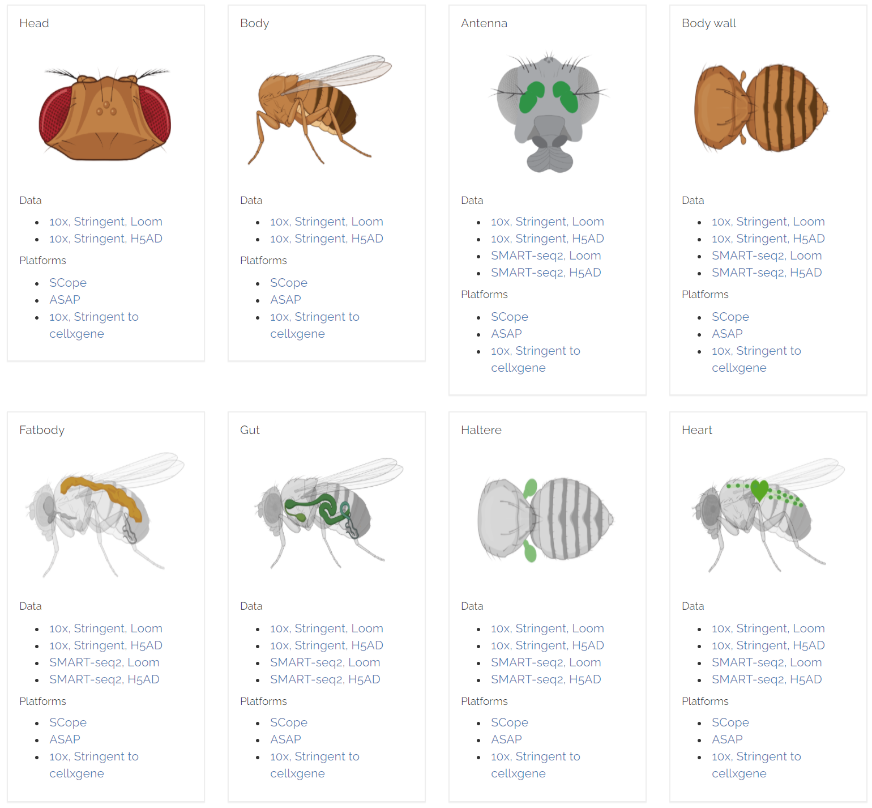
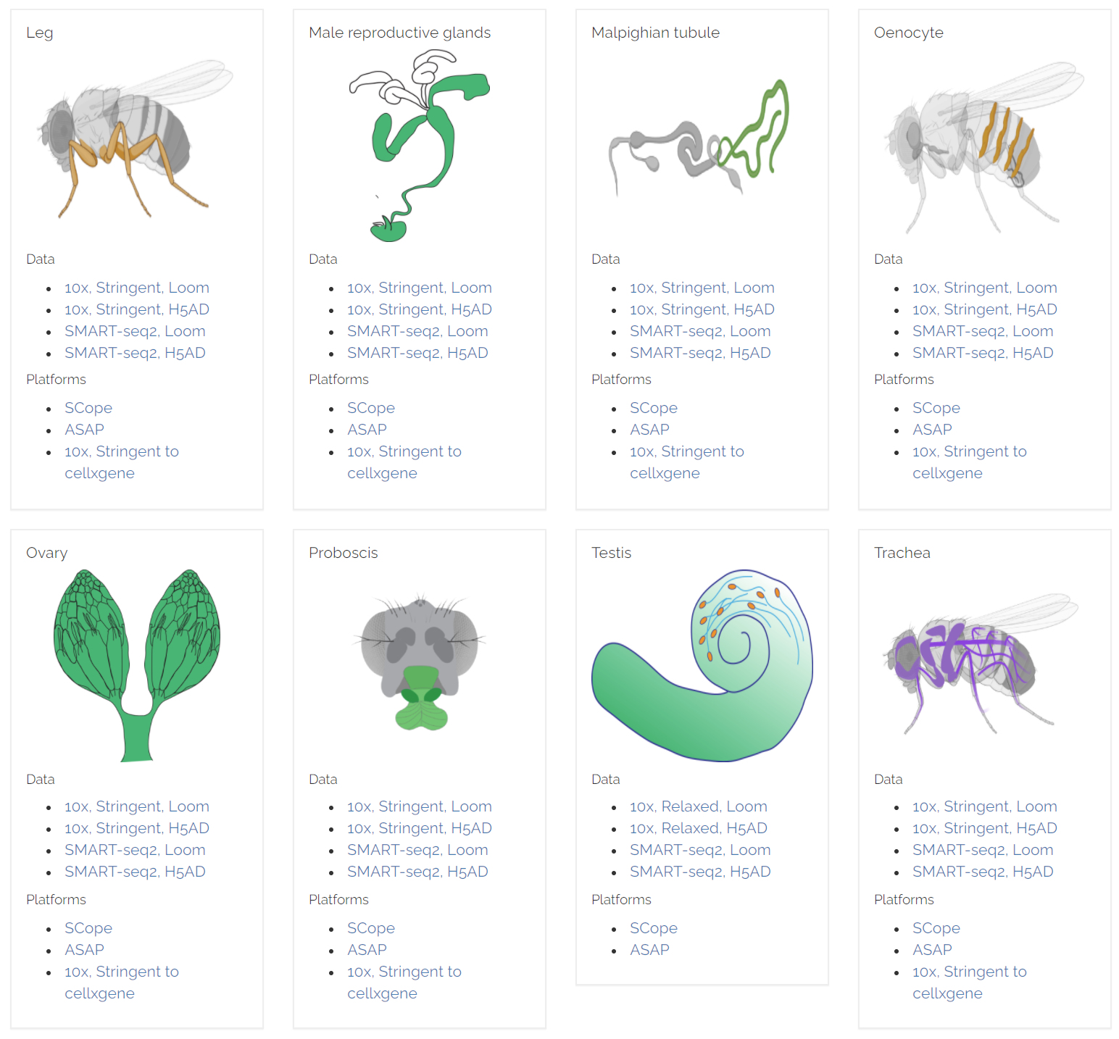
Single-cell studies: the power of the many
Nowadays, independent, non-related, oriented studies are building multi-faceted single-cell atlases of human and model organisms.
https://flycellatlas.org/
Notes:
I would like to expand these observations to in vivo data. I also want to check what happens in terms of transcriptional dynamics in cells where Cyclin O, a key non-canonical cyclin involved in MCC diff., is knocked-out.

Slide 31
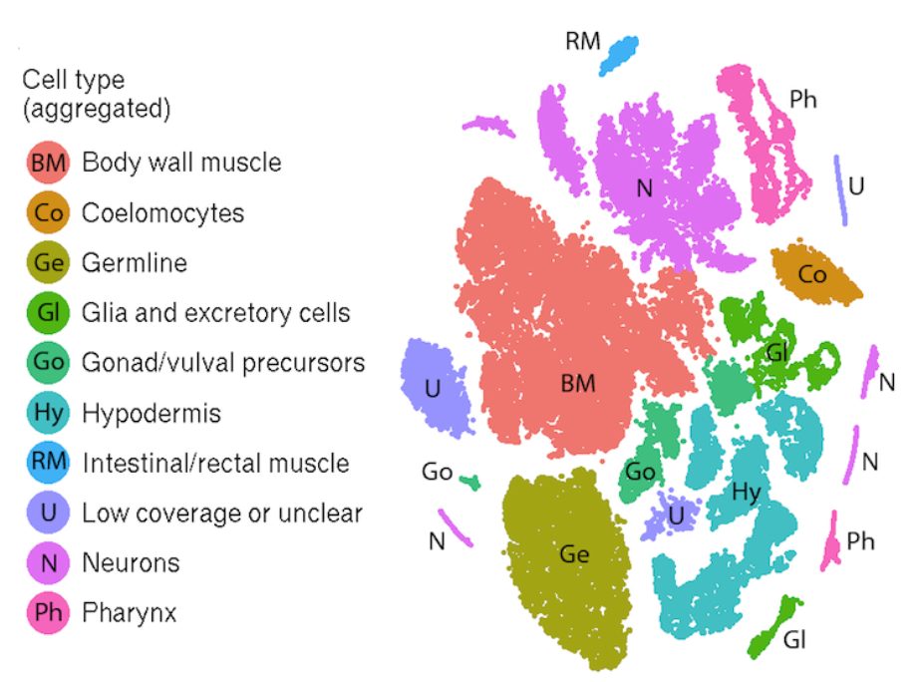
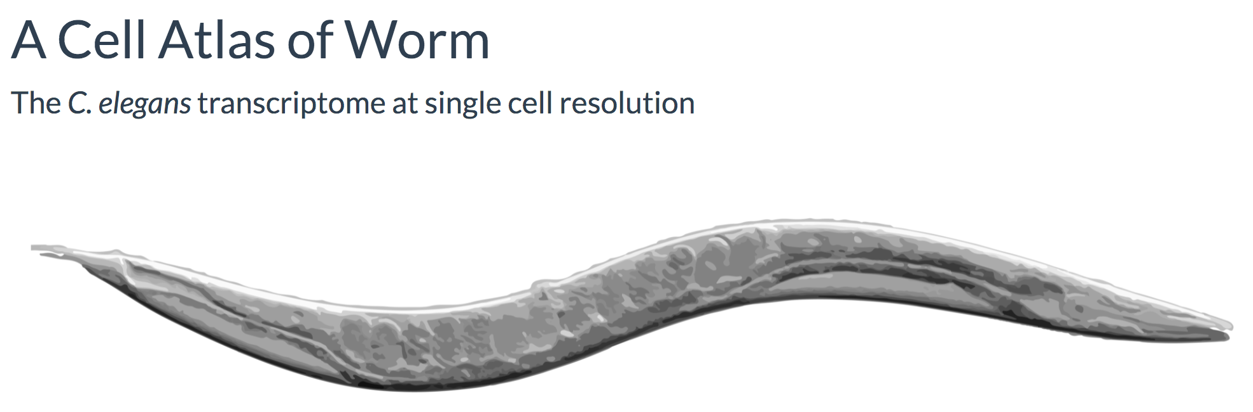
Single-cell studies: the power of the many
Nowadays, independent, non-related, oriented studies are building multi-faceted single-cell atlases of human and model organisms.
https://atlas.gs.washington.edu/worm-rna/
Notes:
I would like to expand these observations to in vivo data. I also want to check what happens in terms of transcriptional dynamics in cells where Cyclin O, a key non-canonical cyclin involved in MCC diff., is knocked-out.

Slide 32
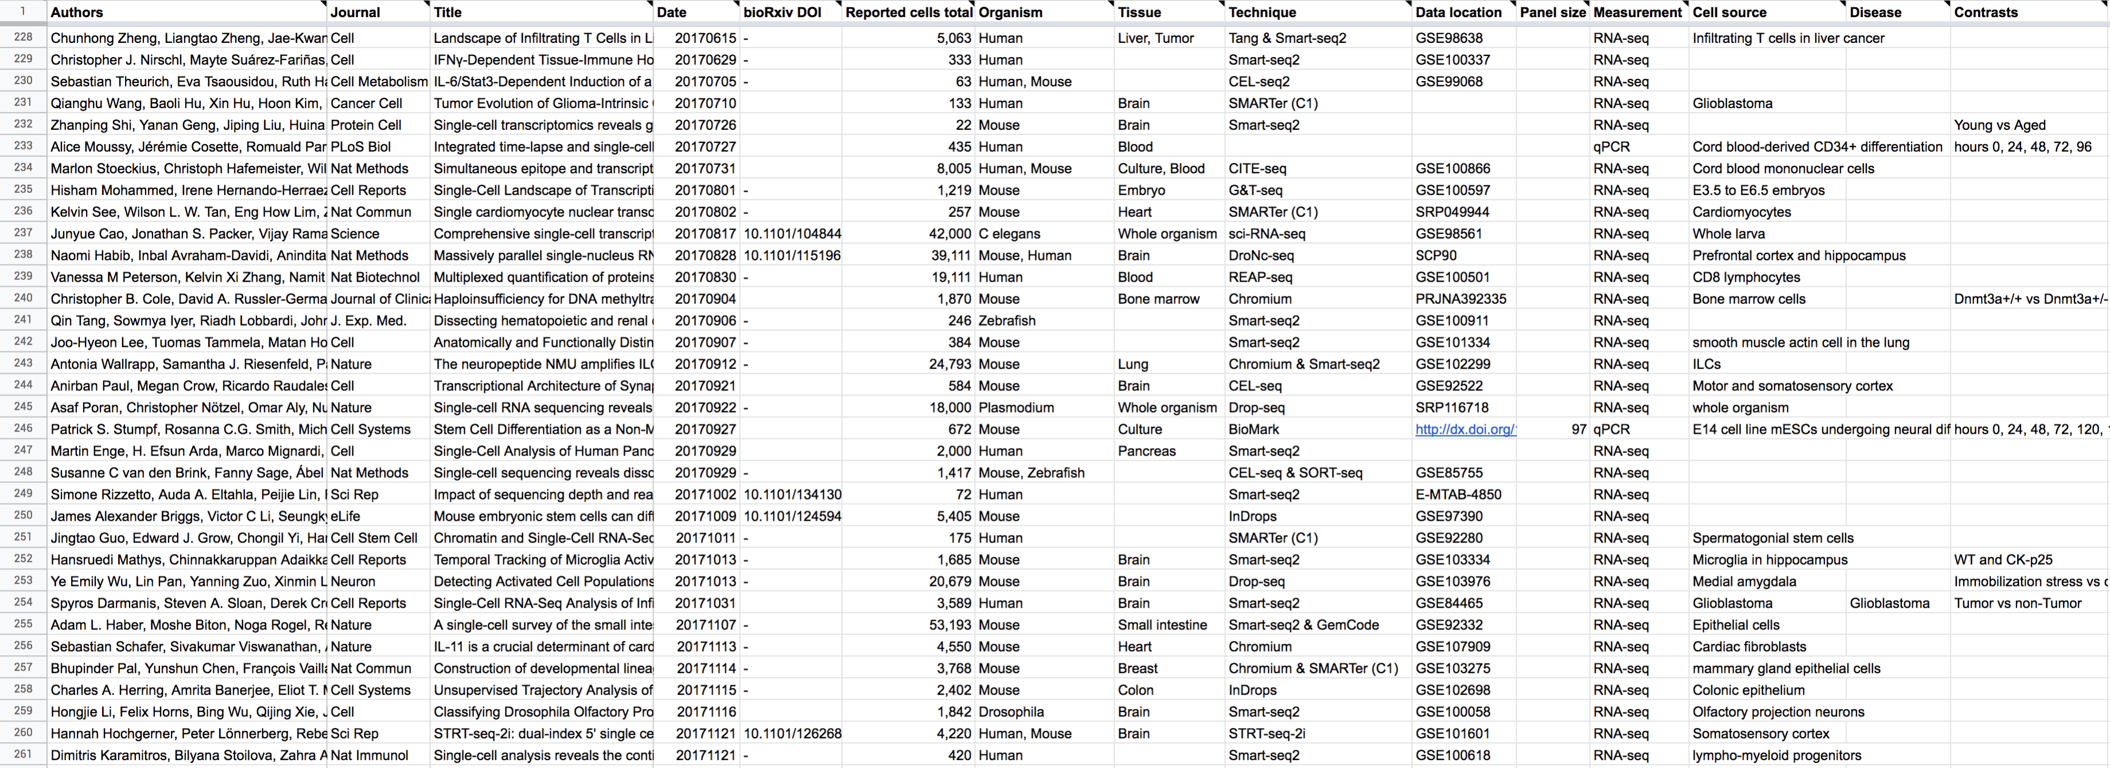
Resources
www.nxn.se/single-cell-studies/gui
1,369 listed studies (as of 2021-09-20)
Svensson et al., Databases 2020
Notes:
I would like to expand these observations to in vivo data. I also want to check what happens in terms of transcriptional dynamics in cells where Cyclin O, a key non-canonical cyclin involved in MCC diff., is knocked-out.

Slide 33
Single-cell studies: the power of the many
Never was so much owed by so many to so “few”
-- Churchill
Notes:
I would like to expand these observations to in vivo data. I also want to check what happens in terms of transcriptional dynamics in cells where Cyclin O, a key non-canonical cyclin involved in MCC diff., is knocked-out.

Slide 34
Single-cell studies: the power of the many
Never was so much owed by so many to so “few”
-- Churchill
It used to be true in the “old days” of large consortia:
Human Genome Project
ENCODE
1000 Genomes
...
Notes:
I would like to expand these observations to in vivo data. I also want to check what happens in terms of transcriptional dynamics in cells where Cyclin O, a key non-canonical cyclin involved in MCC diff., is knocked-out.

Slide 35
Single-cell studies: the power of the many
Nowadays, independent, non-related, oriented studies are building multi-faceted single-cell atlases of human.
Notes:
I would like to expand these observations to in vivo data. I also want to check what happens in terms of transcriptional dynamics in cells where Cyclin O, a key non-canonical cyclin involved in MCC diff., is knocked-out.

Slide 36
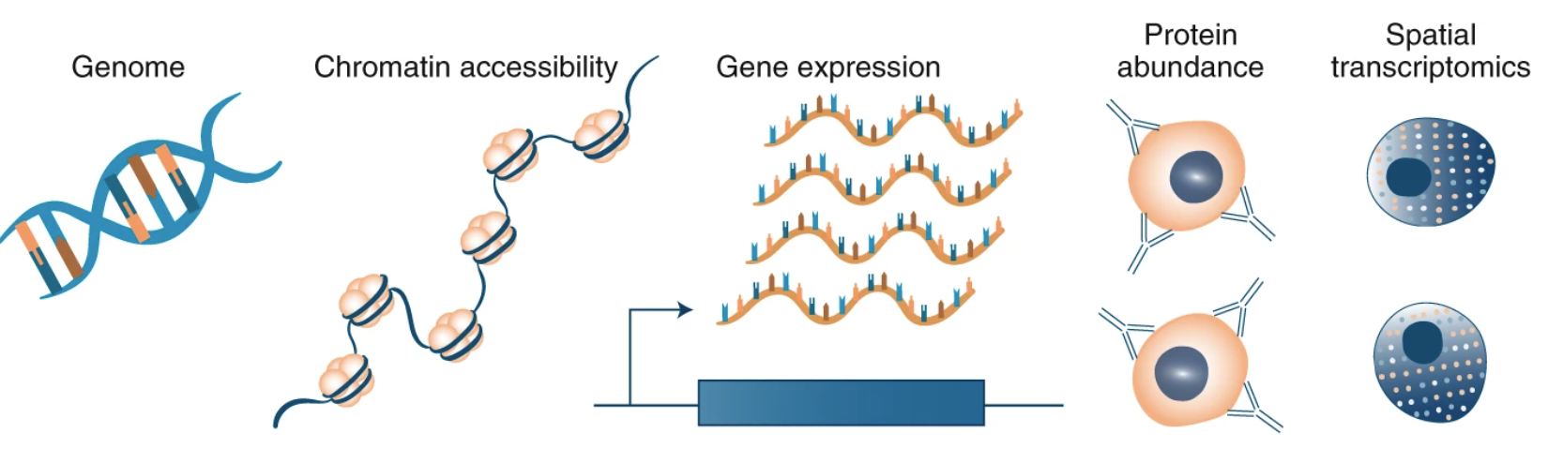
Next-generation single-cell studies: multi-modal assays
DNA and epigenome
Genome sequencing (WES, WGS)
Epigenomics (HiC, ChIP, ATAC, mC )
RNA and transcriptome
Full length transcript abundance
Splicing variants
Transcript localization
Proteins
Multi-parameter flow cytometry
Mass-spectrometry
Efremova M. et al. Nature Methods. 2020
Notes:
I would like to expand these observations to in vivo data. I also want to check what happens in terms of transcriptional dynamics in cells where Cyclin O, a key non-canonical cyclin involved in MCC diff., is knocked-out.

Slide 37

Next-generation single-cell studies: multi-modal assays
DNA and epigenome
Genome sequencing (WES, WGS)
Epigenomics (HiC, ChIP, ATAC, mC )
RNA and transcriptome
Full length transcript abundance
Splicing variants
Transcript localization
Proteins
Multi-parameter flow cytometry
Mass-spectrometry
Multi-omics
DNA+RNA
RNA+protein
Epigenome + RNA
Efremova M. et al. Nature Methods. 2020
Notes:
I would like to expand these observations to in vivo data. I also want to check what happens in terms of transcriptional dynamics in cells where Cyclin O, a key non-canonical cyclin involved in MCC diff., is knocked-out.

Slide 38
Next-generation single-cell studies: multi-modal assays
Single-cell
Single-cell
Single-cell
Single-cell
DNA and epigenome
Genome sequencing (WES, WGS)
Epigenomics (HiC, ChIP, ATAC, mC )
RNA and transcriptome
Full length transcript abundance
Splicing variants
Transcript localization
Proteins
Multi-parameter flow cytometry
Mass-spectrometry
Multi-omics
DNA+RNA
RNA+protein
Epigenome + RNA
Efremova M. et al. Nature Methods. 2020
Notes:
I would like to expand these observations to in vivo data. I also want to check what happens in terms of transcriptional dynamics in cells where Cyclin O, a key non-canonical cyclin involved in MCC diff., is knocked-out.

Slide 39
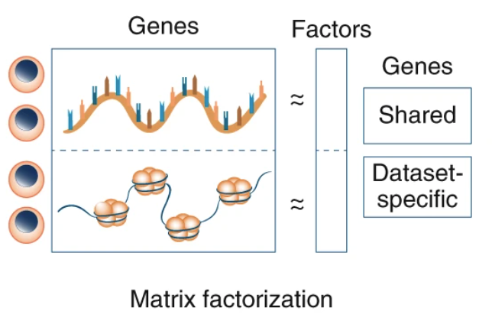
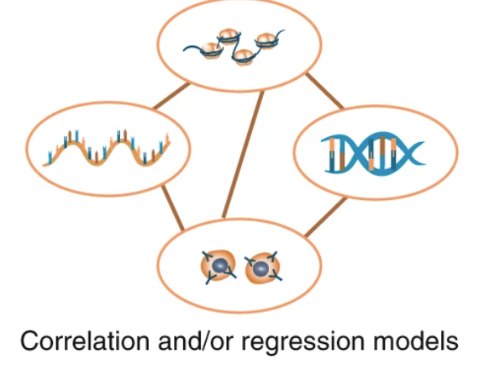
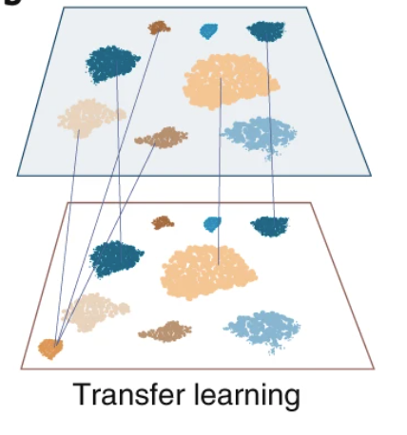
Next-generation single-cell studies: multi-modal assays
Efremova M. et al. Nature Methods. 2020
Notes:
I would like to expand these observations to in vivo data. I also want to check what happens in terms of transcriptional dynamics in cells where Cyclin O, a key non-canonical cyclin involved in MCC diff., is knocked-out.

Slide 40
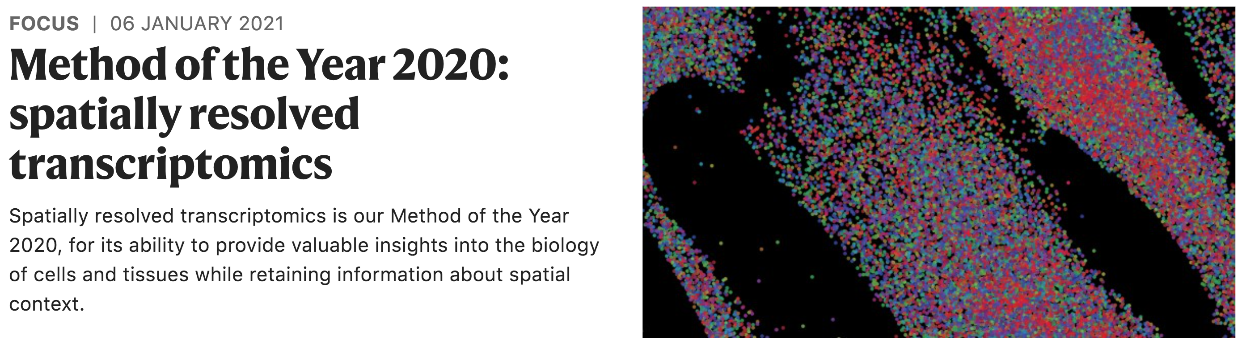
Method of the year 2020: Spatially-resolved transcriptomics
Notes:
I would like to expand these observations to in vivo data. I also want to check what happens in terms of transcriptional dynamics in cells where Cyclin O, a key non-canonical cyclin involved in MCC diff., is knocked-out.

Slide 41
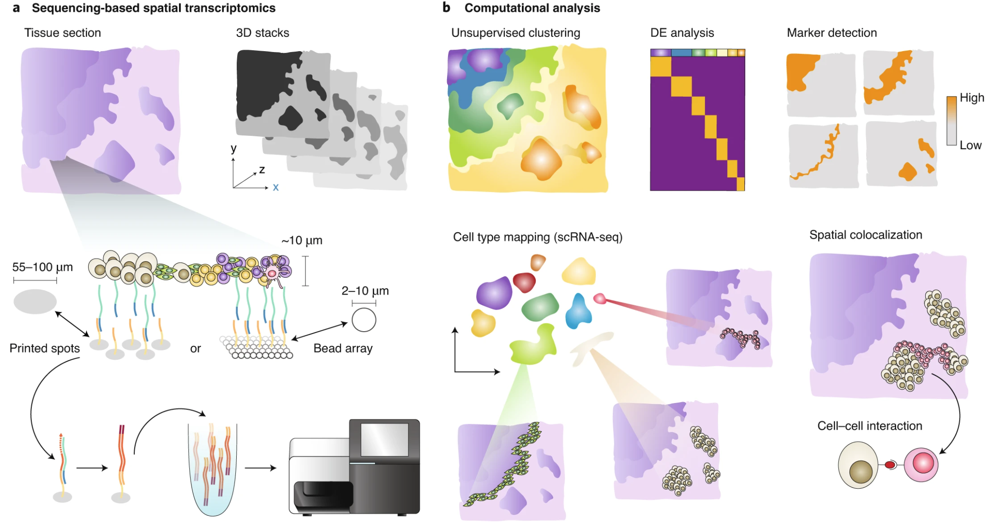
Method of the year 2020: Spatially-resolved transcriptomics
Larsson et al., Nature Methods 2021
Notes:
I would like to expand these observations to in vivo data. I also want to check what happens in terms of transcriptional dynamics in cells where Cyclin O, a key non-canonical cyclin involved in MCC diff., is knocked-out.

Slide 42
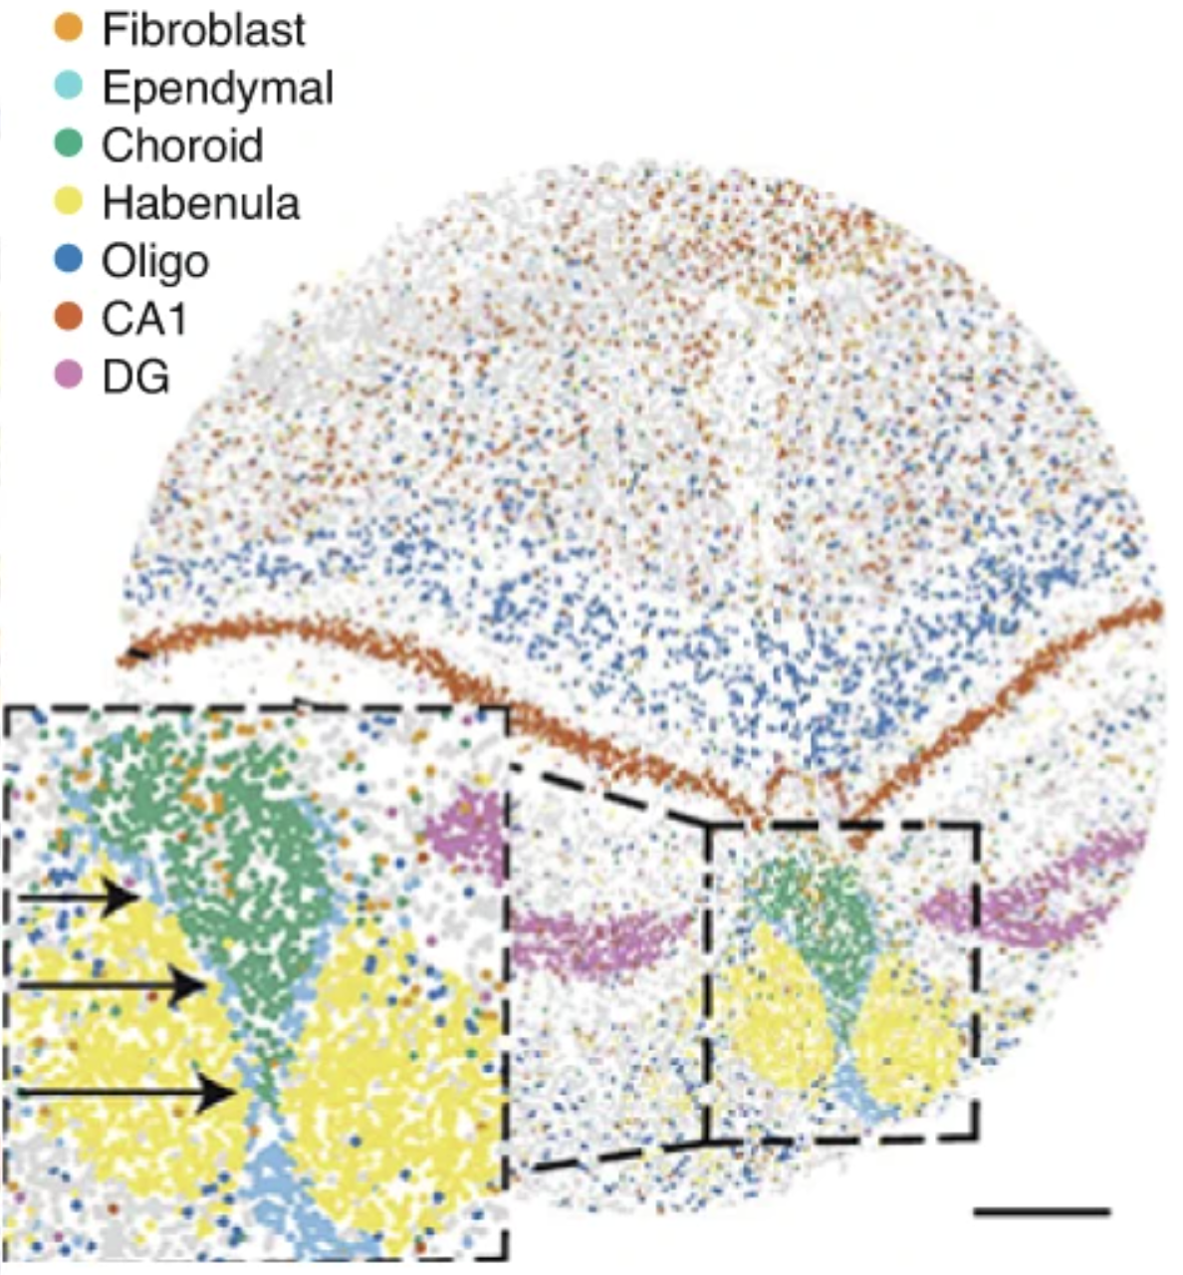
Method of the year 2020: Spatially-resolved transcriptomics
Slide-Seq:
RNA is spatially resolved from tissue sections by transfer onto a surface covered with DNA-barcoded beads.
Rodriques et al., Science 2019
Notes:
I would like to expand these observations to in vivo data. I also want to check what happens in terms of transcriptional dynamics in cells where Cyclin O, a key non-canonical cyclin involved in MCC diff., is knocked-out.

Slide 43
Questions?

